Slide 1


Unit-03 Tools and Methods Used in Cybercrime
Dept. of CSE(CS), MSRIT

Slide 2
Basic Stages of Attack
1. Initial uncovering:
In the first step called as reconnaissance, the attacker gathers information, as much as possible, about the target by legitimate means.
In the second step, the attacker uncovers as much information as possible on the company’s internal network.
2. Network probe: A “ping sweep” of the network IP addresses is performed to seek out potential targets, and then a “port scanning” tool is used to discover exactly which services are running on the target system.
3. Crossing the line toward electronic crime (E-crime): Now the attacker is toward committing what is technically a “computer crime” by exploiting possible holes on the target system.
4. Capturing the network: At this stage, the attacker attempts to “own” the network. The attacker gains a foothold in the internal network quickly and easily.
5. Grab the data: Now that the attacker has “captured the network,” he/she takes advantage of his/her position to steal confidential data, customer credit card information, deface webpages, alter processes and even launch attacks at other sites from your network.
6. Covering tracks: This is the last step in any cyberattack, which refers to the activities undertaken by the attacker to extend misuse of the system without being detected.
Dept. of CSE(CS), MSRIT

Slide 3
Types of Attacks
Scareware:-
Malvertising
Clickjacking
Ransomware
Dept. of CSE(CS), MSRIT

Slide 4
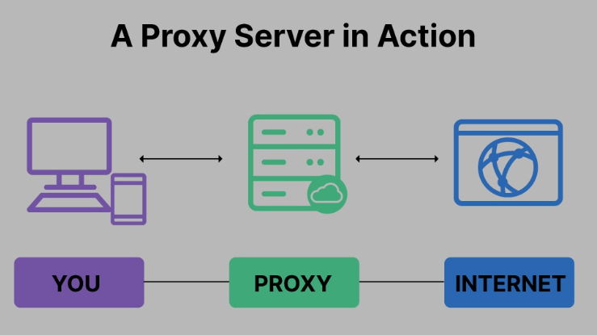
Proxy Server
Dept. of CSE(CS), MSRIT

Slide 5
Proxy Server
Proxy server is a computer on a network which acts as an intermediary for connections with other computers on that network.
Proxy server refers to a server that acts as an intermediary between the request made by clients, and a particular server for some services or requests for some resources.
There are different types of proxy servers available that are put into use according to the purpose of a request made by the clients to the servers.
Dept. of CSE(CS), MSRIT

Slide 6
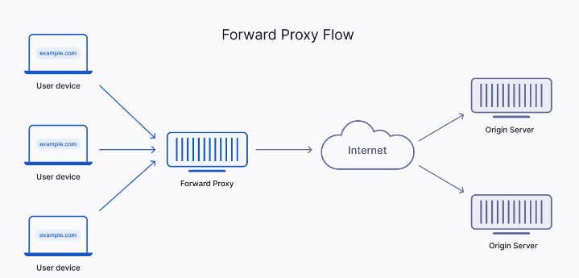
Types of Proxy Servers
Forward Proxy:-
Dept. of CSE(CS), MSRIT

Slide 7
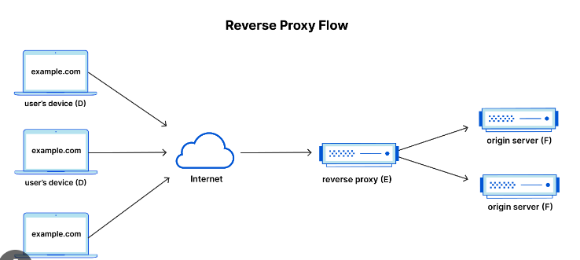
Types of Proxy Servers
Reverse Proxy:-
Dept. of CSE(CS), MSRIT

Slide 8
Types of Proxy Servers
Anonymous Proxy:-
An anonymous proxy keeps private the browsing history
Helps to avoid content blocks and targeted marketing, and it blocks online ads
Provides access to geo-restricted websites
Runs automated tasks
It speeds up loading times when caching configuration is set up.
Dept. of CSE(CS), MSRIT

Slide 9
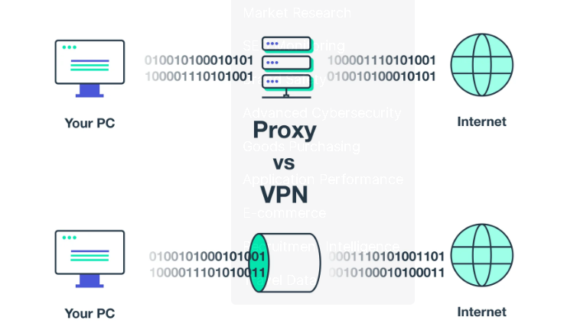
Difference between Proxy and VPN
Dept. of CSE(CS), MSRIT

Slide 10
Proxy Servers and Anonymizers
r
A proxy server has following purposes:
Keep the systems behind the curtain.
Speed up access to a resource (through “caching”).
Specialized proxy servers are used to filter unwanted content such as advertisements.
Proxy server can be used as IP address multiplexer to enable to connect number of computers on the Internet, whenever one has only one IP address.
An anonymous proxy is a tool that attempts to make activity on the Internet untraceable.
It accesses the Internet on the user’s behalf, protecting personal information by hiding the source computer’s identifying information.
Dept. of CSE(CS), MSRIT

Slide 11
Phishing Works
Phishing
Phishing is a fake or false e-mail which can infect systems with in addition to stealing personal and financial data.
How Phishing Works? <
Phishers work in the following ways:
Planning (decide the target)
Setup (create methods for delivering the message and to collect the data about the target)
Attack (phisher sends a phony message)
Collection (record the information of victims)
Identity theft and fraud (use the information that they have gathered to make illegal purchases or commit fraud).
Dept. of CSE(CS), MSRIT

Slide 12
Password Cracking
Password cracking is a process of recovering passwords from data that have been stored in or transmitted by a computer system. Examples of guessable passwords include:
1. Blank (none);
2. the words like “password,” “passcode” and “admin”;
3. series of letters from the “QWERTY” keyboard, for example, qwerty, asdf or qwertyuiop;
4. user’s name or login name;
5. name of user’s friend/relative/pet;
6. user’s birthplace or date of birth, or a relative’s or a friend’s;
7. user’s vehicle number, office number, residence number or mobile number;
8. name of a celebrity who is considered to be an idol (e.g., actors, actress, spiritual gurus) by the user;
9. simple modification of one of the preceding, such as suffixing a digit, particularly 1, or reversing the order of letters.
Dept. of CSE(CS), MSRIT

Slide 13
Password Cracking
Password cracking attacks can be classified under three categories as follows:
1. Online attacks;
2. Offline attacks;
3. Non-electronic attacks (e.g., social engineering, shoulder surfing and dumpster diving).
Dept. of CSE(CS), MSRIT

Slide 14
Online Attacks
The most popular online attack is man-in-the middle (MITM) attack, also termed as “bucket-brigade attack” or sometimes “Janus attack.”
It is a form of active eavesdropping in which the attacker establishes a connection between a victim and the server to which a victim is connected.
Offline Attacks
Offline attacks usually require physical access to the computer and copying the password file from the system onto removable media.
Dept. of CSE(CS), MSRIT

Slide 15
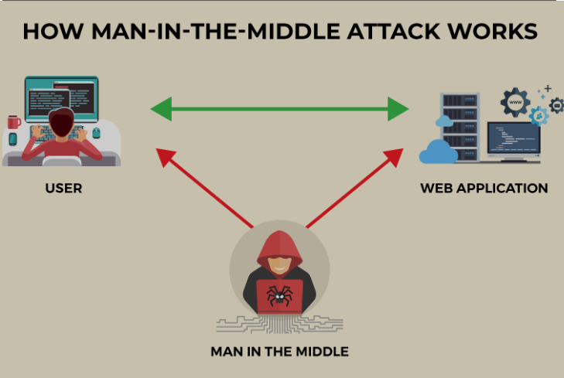
MITM
Dept. of CSE(CS), MSRIT

Slide 16
Password Cracking
Strong, Weak and Random Passwords
A weak password is one, which could be easily guessed, short, common and a system default password that could be easily found by executing a brute force attack and by using a subset of all possible passwords.
A strong password is long enough, random or otherwise difficult to guess – producible only by the user who chooses it.
Random Passwords
Password is stronger if it includes a mix of upper and lower case letters, numbers and other symbols, when allowed, for the same number of characters.
Dept. of CSE(CS), MSRIT

Slide 17
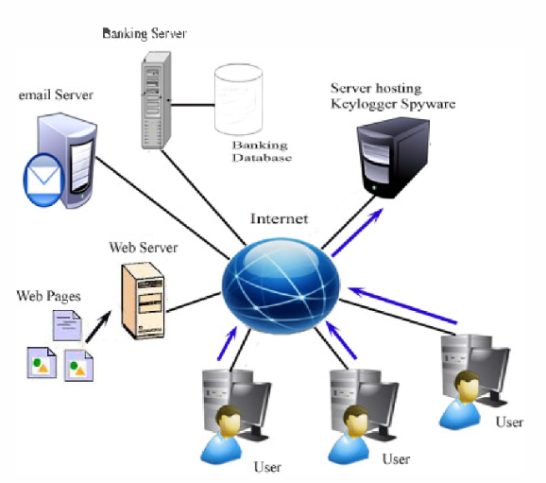
Keyloggers and Spywares
Keystroke logging- practice of noting (or logging) the keys struck on a keyboard.
Keystroke logger or keylogger is quicker and easier way of capturing the passwords and monitoring the victims’ IT savvy behavior.
It can be classified as software keylogger and hardware keylogger.
Dept. of CSE(CS), MSRIT

Slide 18
Keyloggers and Spywares
Software Keyloggers
Software keyloggers are software programs installed on the computer systems which usually are located between the OS and the keyboard hardware, and every keystroke is recorded.
A keylogger usually consists of two files that get installed in the same directory: a dynamic link library (DLL) file and an EXEcutable (EXE) file that installs the DLL file and triggers it to work.
Hardware Keyloggers
Hardware keyloggers are small hardware devices connected to the PC and/or to the keyboard and save every keystroke into a file or in the memory of the hardware device.
These keyloggers look like an integrated part of such systems; hence, bank customers are unaware of their presence.
Dept. of CSE(CS), MSRIT

Slide 19
Keyloggers and Spywares
Anti keylogger
Anti keylogger is a tool that can detect the keylogger installed on the computer system and also can remove the tool.
Firewalls cannot detect the installations of keyloggers on the systems; hence, anti keyloggers can detect installations of keylogger.
This software does not require regular updates of signature bases to work effectively such as other antivirus and antispy programs.
Prevents Internet banking frauds.
It prevents ID theft.
It secures E-Mail and instant messaging/chatting.
Spywares
Spyware is malicious software secretly installed on the user’s personal computer.
Spywares such as keyloggers are installed by the owner of a shared, corporate or public computer on purpose to secretly monitor other users.
Dept. of CSE(CS), MSRIT

Slide 20
Virus and Worms
Computer virus is a program that can “infect” legitimate programs by modifying them to include a possibly “evolved” copy of itself.
Viruses can take some typical actions:
1. Display a message to prompt an action which may set of the virus
2. Delete files inside the system into which viruses enter
3. Scramble data on a hard disk
4. Cause erratic screen behavior
5. Halt the system (PC)
6. Just replicate themselves to propagate further harm.
Dept. of CSE(CS), MSRIT

Slide 21
Virus and Worms
Types of Viruses
Computer viruses can be categorized based on attacks on various elements of the system and can put the system and personal data on the system in danger.
Boot sector viruses
Program viruses
Multipartite viruses
Stealth viruses
Polymorphic viruses
Macro viruses
Active X and Java Control
A computer worm is a self-replicating malware computer program which uses a computer network to send copies of itself to other nodes (computers on the network) and it may do so without any user intervention
Dept. of CSE(CS), MSRIT

Slide 22
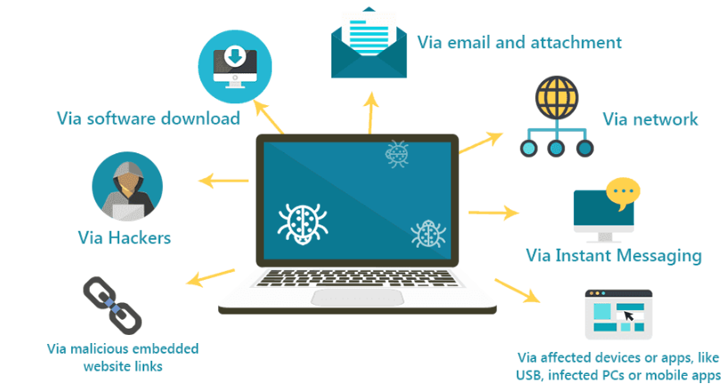
How do Virus Spreads
Dept. of CSE(CS), MSRIT

Slide 23
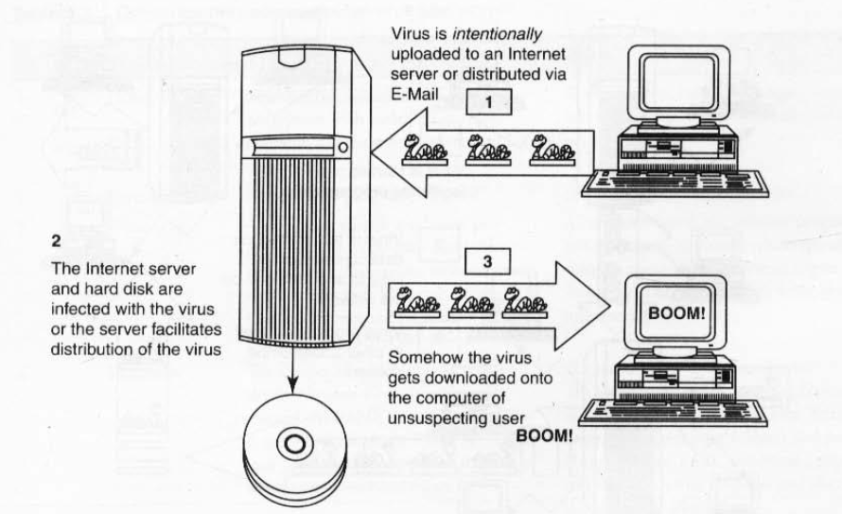
How do Virus Spreads
Fig : How Virus spread through Internet
Dept. of CSE(CS), MSRIT

Slide 24
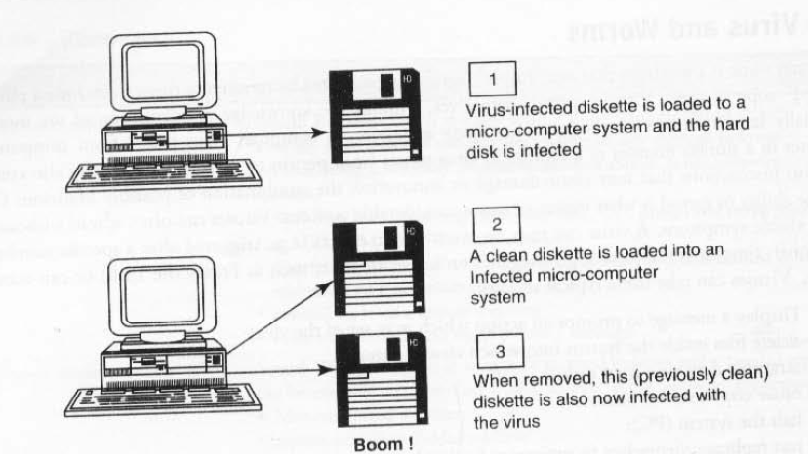
How do Virus Spreads
Fig : How Virus spread through stand alone system
Dept. of CSE(CS), MSRIT

Slide 25
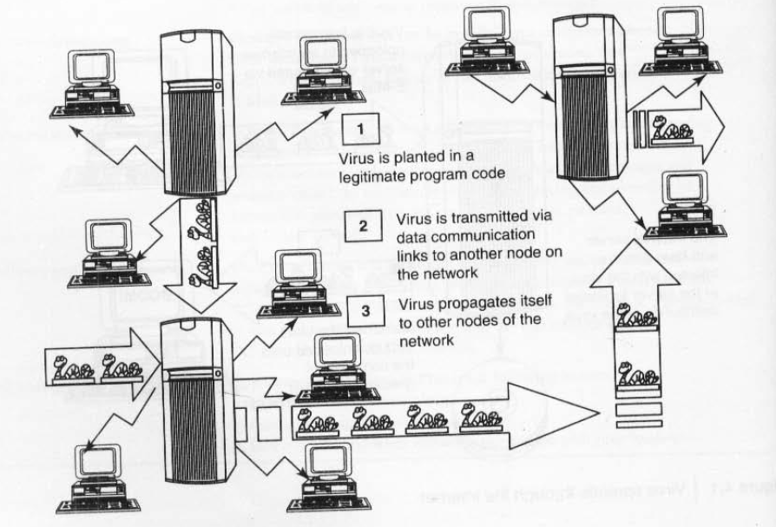
How do Virus Spreads
Fig : How Virus spread through local networks
Dept. of CSE(CS), MSRIT

Slide 26
Types of Viruses
1. Boot Sector Viruses
Infects the boot record.
Spreads when System is booted.
Gains control of machine before the virus detection tools can act .
Very hard to notice.
Carrier files: AUTOEXEC.BAT, CONFIG.SYS, IO.SYS
Dept. of CSE(CS), MSRIT

Slide 27
Types of Viruses
2. Program Viruses
Infects executable program files such as .exe, .ovl, .drv, .bin, .com.
These programs are loaded in memory during execution, taking the virus with them.
Program virus becomes active in memory, making copies of itself and infecting files on disk.
Dept. of CSE(CS), MSRIT

Slide 28
Types of Viruses
3. Multipartite Viruses
It is a hybrid of a boot sector and program viruses. It infects program files along with the boot record when the infected program is active.
Victim’s local drive and other programs will be affected.
Dept. of CSE(CS), MSRIT

Slide 29
Types of Viruses
4. Stealth Viruses
Stealth virus uses can disguise itself ,so antivirus software cannot it.
These viruses attacks operating system processes and binds to files, disk partitions and boot sectors to avoid detection.
It alters its file size and conceals itself in the computer memory to remain in the system undetected.
Dept. of CSE(CS), MSRIT

Slide 30
Types of Viruses-Polymorphic Viruses
Polymorphic virus is a complicated computer virus that changes its form as it propagates to avoid detection by antivirus.
It is a self-encrypting virus that pairs a mutation engine along with a self-propagating program code.
A polymorphic virus corrupts data and slows down system resources, sometimes leading to computer malfunctions like blue screen errors.
Polymorphic Generators are Dark Angel’s Multiple Encryptor(DAME), Darwinian Genetic Mutation Engine(DGME) etc..
Dept. of CSE(CS), MSRIT

Slide 31
Types of Viruses
Macroviruses
Many applications ,such MS word, MS Excel, support macros.
A macro virus operates by injecting its code into macros attached to the type of popular data files associated with office work, like Microsoft Word, Excel, or PowerPoint files.
A macro virus shares the traits of a typical computer virus. Like a regular computer virus, a macro virus needs human interaction to activate
Dept. of CSE(CS), MSRIT

Slide 32
Trojan Horse
Trojan Horse is a program in which malicious or harmful code is contained inside apparently harmless programming or data in such a way that it can get control and cause harm.
Trojans can get into the system in a number of ways, including from a web browser, via E-Mail or in a bundle with other software downloaded from the Internet.
Unlike viruses or worms, Trojans do not replicate themselves but they can be equally destructive.
On the surface, Trojans appear benign and harmless, but once the infected code is executed, Trojans kick in and perform malicious functions to harm the computer system without the user’s knowledge.
Dept. of CSE(CS), MSRIT

Slide 33
Backdoor
A backdoor is a means of access to a computer program that bypasses security mechanisms.
A programmer may sometimes install a backdoor so that the program can be accessed for troubleshooting or other purposes.
An attacker often uses backdoors that they detect or install themselves as part of an exploit.
In some cases, a worm is designed to take advantage of a backdoor created by an earlier attack.
Dept. of CSE(CS), MSRIT

Slide 34
What a Backdoor Does?
It allows an attacker to create, delete, rename, copy or edit any file, execute any commands, or change system settings.
Install arbitrary software and parasites.
It allows the attacker to control computer hardware devices, modify related settings, and shut down and restart a computer without the user’s permission.
It steals all sensitive personal information, valuable documents, passwords, and login IDs and also tracks web browsing habits.
It installs a hidden FTP server that can be used by malicious persons for various illegal purposes.
It degrades internet connection speeds, and overall performance, decreases system security and causes software inability.
Dept. of CSE(CS), MSRIT

Slide 35
Examples of Backdoor Trojans
Back Orifice
Bifrost
SAP Backdoors
Onapsis Bizploit
Dept. of CSE(CS), MSRIT

Slide 36
How to Protect from Trojan Horses and Backdoors
Stay away from suspect websites/weblinks
Surf on the Web cautiously
Install antivirus/Trojan remover software
Dept. of CSE(CS), MSRIT

Slide 37
Steganography
The steganography technique involves hiding sensitive information within an ordinary, non-secret file or message so that it will not be detected.
The sensitive information will then be extracted from the ordinary file or message at its destination, thus avoiding detection.
Steganography is an additional step that can be used in conjunction with encryption in order to conceal or protect data.
Dept. of CSE(CS), MSRIT

Slide 38
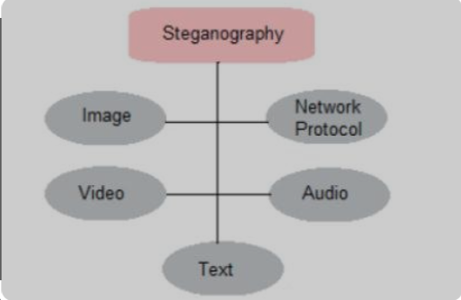
Different Types of Steganography
Text Steganography
Image Steganography
Audio Steganography
Video Steganography
Network or Protocol Steganography
Dept. of CSE(CS), MSRIT

Slide 39
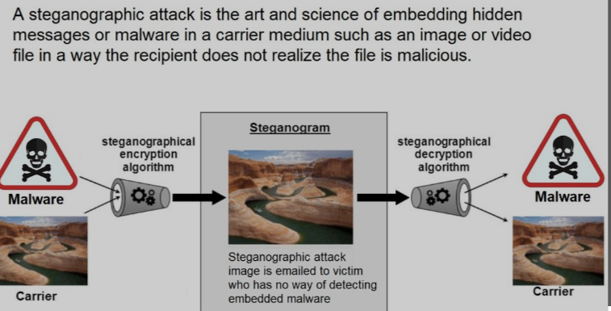
Steganography
Dept. of CSE(CS), MSRIT

Slide 40
Steganography Examples
Writing with invisible ink
Embedding text in a picture (like an artist hiding their initials in a painting they’ve done)
Backward masking a message in an audio file (remember those stories of evil messages recorded backward on rock and roll records?)
Concealing information in either metadata or within a file header
Hiding an image in a video, viewable only if the video is played at a particular frame rate
Embedding a secret message in either the green, blue, or red channels of an RRB image
Dept. of CSE(CS), MSRIT

Slide 41
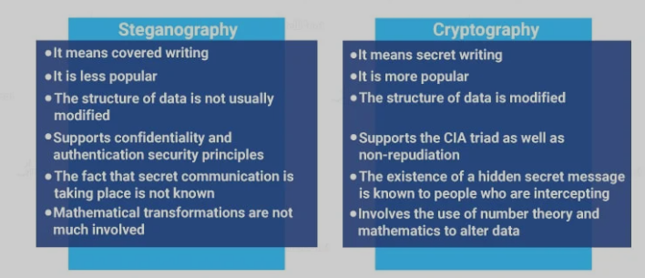
Difference between Steganography and Cryptography
Dept. of CSE(CS), MSRIT

Slide 42
How Steganography is different from obufuscation?
Obfuscation deliberately makes the message hard to interpret, read, or decode.
Cyber-security professionals employ obfuscation to protect sensitive information such as programming codes.
The process makes it difficult for hackers to read the codes in the first place, which in turn prevents them from exploiting the data.
Dept. of CSE(CS), MSRIT

Slide 43
Steganography Techniques
Secure Cover Selection
Least Significant Bit
Palette Based Technique
Dept. of CSE(CS), MSRIT

Slide 44
Steganography Tools
Steghide: Steghide is a free tool that uses steganography to conceal information in other files, such as media or text.
Stegosuite: It is a Java-based, free steganography tool. Stegosuite makes it simple to obfuscate data in pictures for covert purposes.
OpenPuff: It is a high-quality steganographic tool that allows you to conceal data in other media types like images, videos, and Flash animations.
Xiao Steganography: To conceal information in BMP images or WAV files, use the free Xiao Steganography tool.
SSuite Picsel: The free portable program SSuite Picsel is yet another option for hiding text within an image file; however, it uses a somewhat different method than other programs.
Dept. of CSE(CS), MSRIT

Slide 45
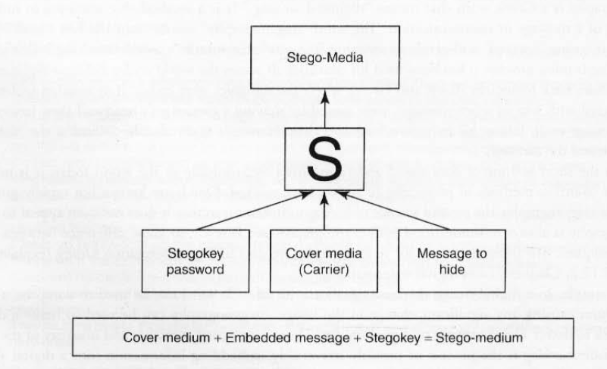
How Steganography Works
Dept. of CSE(CS), MSRIT

Slide 46
Advantages of Steganography
Steganography is a form of encryption that protects the information within a message and the connections between sender and receiver.
Hiding communications.
Security, capacity, and robustness
You can store an encrypted copy of a file containing sensitive information on the server without fear of unauthorized parties gaining access to the data.
Government and law enforcement agencies can communicate secretly with the help of steganography corporations.
Dept. of CSE(CS), MSRIT

Slide 47
Steganography Tools
DiSi-Steganography
It is a very small, DoS-based steganography program that embeds data in PCX images.
Invisible Folders
It can make any file or folder invisible to anyone using your PC even on a network.
Invisible Secrets:-
It not only encrypts the data and files for safe-keeping or for secure transfer across the Net but also hides them in places.
Hermetic Stego:- Steganography program that allows encrypting and hide contents of any data file in another file so that the addition of the data to the container file will not noticeably change the appearance of that file.
DCPP(DriveCrypt Plus):- Secure hiding of an entire OS inside the free space of another OS. Full disk encryption, preboot authentication
Dept. of CSE(CS), MSRIT

Slide 48
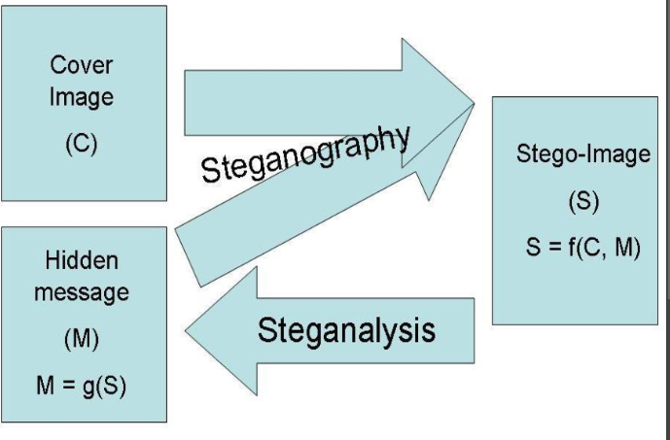
Steganography and Steganalysis
Steganalysis is the art and science of detecting messages that are hidden in images, audio/video files using steganography.
Automated tools are used to detect such steganographed data/information hidden in the image and audio and/or video files.
Dept. of CSE(CS), MSRIT

Slide 49
Steganography Tools
StegAlyzerAS
It is a very small, DoS-based steganography program that embeds data in PCX images.
StegAlzyerSS
It can make any file or folder invisible to anyone using your PC even on a network.
StegSpy:-
It not only encrypts the data and files for safe-keeping or for secure transfer across the Net but also hides them in places.
Stegdetect
Stegsecret
VSL(Virtual Steganographic laboratory)
Dept. of CSE(CS), MSRIT

Slide 50
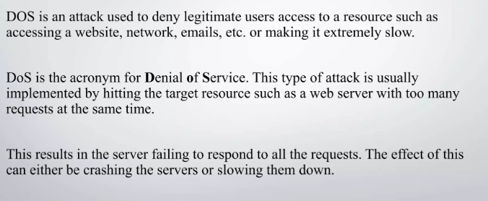
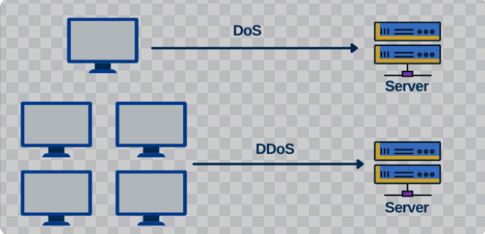
DOS (Denial Of Service) Attacks
Dept. of CSE(CS), MSRIT

Slide 51
DOS (Denial Of Service) and DDOS(Distributed DOS) Attacks
A denial-of-service attack (DoS attack) or distributed denial-of-service attack (DDoS attack) is an attempt to make a computer resource unavailable to its intended users.
DOS Attacks:-
The attacker floods the bandwidth of the victim’s network or fills his E-Mail box with Spam mail depriving him of the services he is entitled to access or provide.
The goal of DoS is not to gain unauthorized access to systems or data, but to prevent intended users (i.e., legitimate users) of a service from using it.
1. Flood a network with traffic, thereby preventing legitimate network traffic.
2. Disrupt connections between two systems, thereby preventing access to a service.
3. Prevent a particular individual from accessing a service.
4. Disrupt service to a specific system or person.
Dept. of CSE(CS), MSRIT

Slide 52
DOS (Denial Of Service)
Symptoms of DOS Attacks:-
Usually slow network performance(opening files or accessing websites)—Such as long load times for files or websites.
Unavailability of a particular website
Inability to access any website
A sudden loss of connectivity across devices on same network.
Increase in the number of Spam E-mails received(E-Mail Bomb)
Dept. of CSE(CS), MSRIT

Slide 53
DOS (Denial Of Service) Attacks
Buffer Overflow Technique
It is the most common form of DOS attack.
The adversary drives more traffic to a network address than the system is capable of handling.
Buffer Overflow technique is used to commit Spoofing(IP address Spoofing).
IP address Spoofing
Creation of IP packets with forged source IP address(To Conceal ID of Sender)
The attacker spoofs the IP address and floods the network of the victim with repeated requests.
As the IP address is fake, the Victim machine keeps on waiting for the response from the attacker’s machine(a lot of Bandwidth of the network will be consumed…failed to serve legitimate requests.)
Dept. of CSE(CS), MSRIT

Slide 54
Classification of DOS Attacks
Bandwidth Attacks: target the Network’s bandwidth, available computing resources
Logic Attacks can exploit vulnerabilities in network software such as web server or TCP/IP stack.
Protocol Attacks exploit a specific feature or implementation bug of some protocol installed at the victim’s system to consume excess amounts of its resources.
Unintentional DOS attack– Due to a sudden spike in popularity
Dept. of CSE(CS), MSRIT

Slide 55
Types or levels of DOS Attacks
Flood attack(ping flood)
The attacker sends the victim an overwhelming number of ping packets using ping commands.
The attacker requires a faster network connection than the victim.
Simply to launch, however difficult to prevent.
For Example: an ICMP flood attack occurs when a system receives too many ICMP ping commands and must use all its resources to send reply commands.
Dept. of CSE(CS), MSRIT

Slide 56
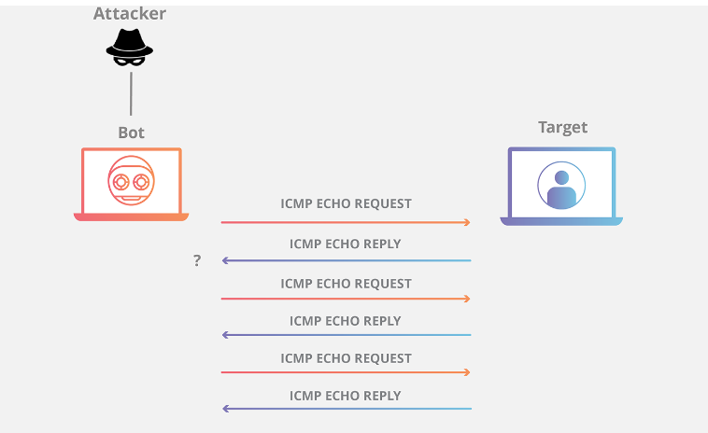
Ping Flood
Dept. of CSE(CS), MSRIT

Slide 57
Types or levels of DOS Attacks
Ping of death attack
The ping of death attack sends oversized ICMP packets.
The maximum packet size allowed is 65,536 octets.
Some systems upon receiving the oversized packet, will crash, freeze or reboot, resulting in DOS.
Dept. of CSE(CS), MSRIT

Slide 58
Types or levels of DOS Attacks
SYN attack(TCP SYN Flooding)
In the TCP, handshaking is done with SYN and ACK messages.
An attacker initiates a TCP connection to the server with an SYN(using spoof source address).
The Server replies with a SYN-ACK. The client does not send back ACK, causing the server to allocate memory for pending connection and wait.
This fills buffer space for SYN messages in the target system and prevents other systems from communicating.
Dept. of CSE(CS), MSRIT

Slide 59
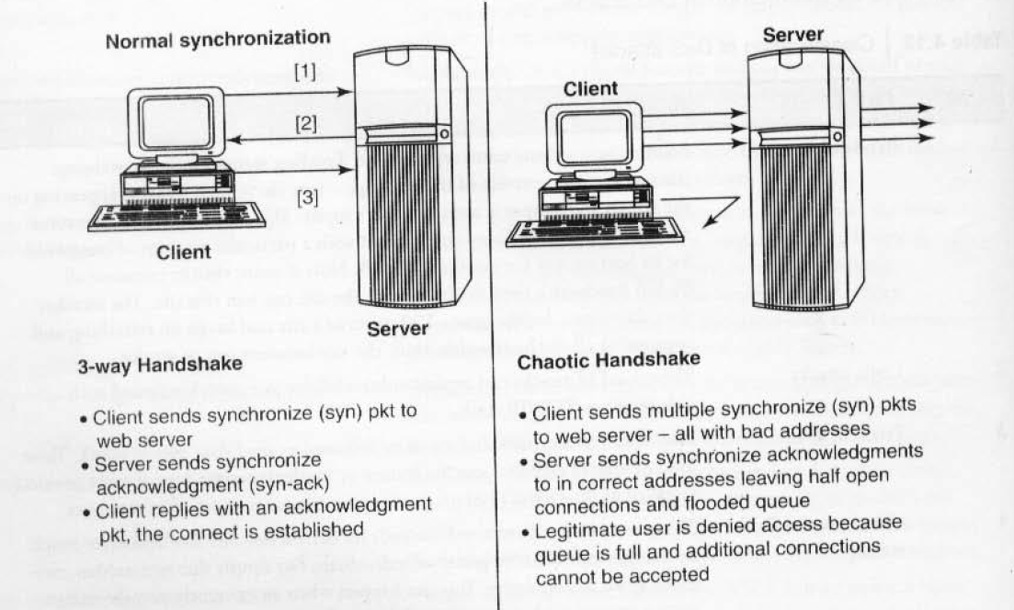
Denial of Service (DOS) Attack
Dept. of CSE(CS), MSRIT

Slide 60
Levels of Denial of Service (DOS) Attack
Teardrop attack
Fragmented IP packets are forged to overlap each other when receiving host tries to reassemble them.
IP’s packet fragmentation algorithm is used to send corrupted packets to confuse the victim and will hang the system.
Smurf attack
Floods the target system via spoofed ping messages.
Deals with ICMP echo request and ICMP echo response.
Nuke attack
Old DOS attack.
Invalid ICMP packets sent to the target.
Dept. of CSE(CS), MSRIT

Slide 61
DDOS Attack
In a DDoS attack, an attacker may use your computer to attack another computer.
By taking advantage of security vulnerabilities or weaknesses, an attacker could take control of your computer.
He/she could then force your computer to send huge amounts of data to a website or send Spam to particular E-Mail addresses.
A DDoS attack is a distributed DoS wherein a large number of zombie systems are synchronized to attack a particular system. The zombie systems are called “secondary victims” and the main target is called “primary victim.”
DDoS attacks involves hardcoding the target IP address prior to release of the malware, hence no further interaction is necessary to launch the attack.
A system may also be compromised with a Trojan, allowing the attacker to download a zombie agent.
Dept. of CSE(CS), MSRIT

Slide 62
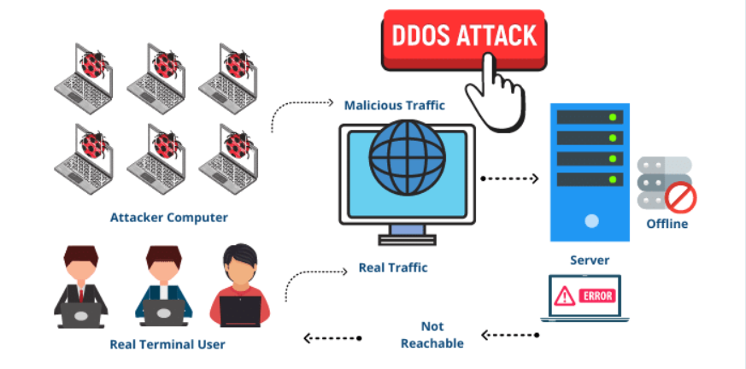
DDOS Attack
Dept. of CSE(CS), MSRIT

Slide 63
How to protect from DDOS/DOS Attack
.
1. Implement router filters.
2. If such filters are available for your system, install patches to guard against TCP SYN flooding.
3. Disable any unused or inessential network service.
4. Enable quota systems on your OS if they are available.
5. Observe your system’s performance and establish baselines for ordinary activity
6. Routinely examine your physical security with regard to your current needs.
7. Use Tripwire or a similar tool to detect changes in configuration information or other files.
8. Invest in and maintain “hot spares” – machines that can be placed into service quickly if a similar machine is disabled.
9. Invest in redundant and fault-tolerant network configurations.
10. Establish and maintain regular backup schedules and policies, particularly for important configuration information.
11. Establish and maintain appropriate password policies, especially access to highly privileged accounts such as Unix root or Microsoft Windows NT Administrator.
Dept. of CSE(CS), MSRIT

Slide 64
SQL Injection Attack
SQL injection is a code injection technique that exploits a security vulnerability occurring in the database layer of an application.
The vulnerability is present when user input is either filtered incorrectly for string literal escape characters embedded in SQL statements or user input is not strongly typed and thereby unexpectedly executed.
Attackers target the SQL servers – common database servers used by many organisations to store confidential data.
During an SQL injection attack, Malicious Code is inserted into a web form field or the website’s code to make a system execute a command shell or other arbitrary commands.
Just as a legitimate user enters queries and additions to the SQL database via a web form, the attacker can insert commands to the SQL server through the same web form field.
Attackers can use SQL injection vulnerabilities to bypass application security measures.
Dept. of CSE(CS), MSRIT

Slide 65
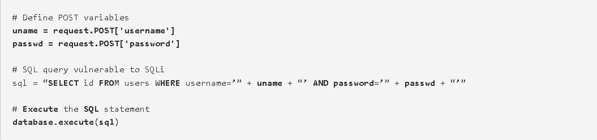

Simple SQL Injection Attack example
These input fields are vulnerable to SQL Injection. An attacker could use SQL commands in the input in a way that would alter the SQL statement executed by the database server. For example, they could use a trick involving a single quote and set the passwd field to:
Dept. of CSE(CS), MSRIT

Slide 66

Simple SQL Injection Attack example
As a result, the database server runs the following SQL query:
Because of the OR 1=1 statement, the WHERE clause returns the first ID from the user table no matter what the username and password are:
Dept. of CSE(CS), MSRIT

Slide 67
Blind SQL Injection
Blind SQL Injection
Blind SQL injection is used when a web application is vulnerable to an SQL injection but the results of the injection are not visible to the attacker.
The page with the vulnerability may not be the one that displays data; however, it will display differently depending on the results of a logical statement injected into the legitimate SQL statement called for that page.
Dept. of CSE(CS), MSRIT

Slide 68
How to prevent SQL Injection Attacks
SQL injection attacks occur due to poor website administration and coding. The following steps can be taken to prevent SQL injection.
Input validation
--Replace all single quotes with two single quotes.
--Sanitize the input
--Numeric value must be checked.
--Keep all the boxes and form fields as short as possible to limit the length of user input.
2. Modify error reports
-- handle error reports carefully—It must not be displayed to outside users.
3. Other preventions
--Isolate data base server and web server.
Dept. of CSE(CS), MSRIT

Slide 69
Attacks on Wireless Networks
The following are different types of “mobile workers”:
Tethered/remote worker
Roaming user
Nomad
Road warrior
Wireless networks extend the range of traditional wired networks by using radio waves to transmit data to wireless-enabled devices such as laptops and PDAs.
Wireless networks are generally composed of two basic elements:
Access points (APs)
Other wireless-enabled devices, such as laptops radio transmitters and receivers to communicate or “connect” with each other.
Dept. of CSE(CS), MSRIT

Slide 70
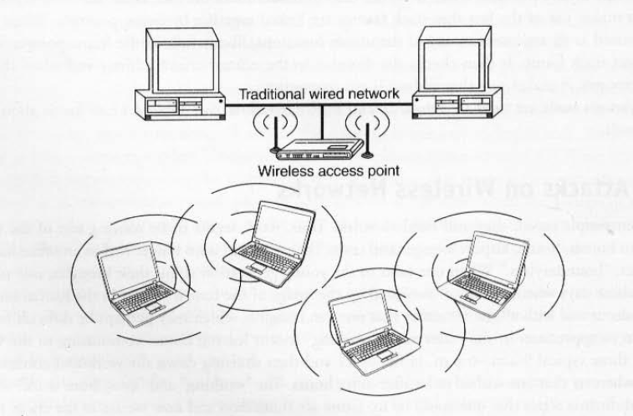
Wireless Networks
Dept. of CSE(CS), MSRIT

Slide 71
Important Terminologies
802.11 networking standards.
Access Points
Wifi hotspots
Service set identifier(SSID)
Wired equivalence privacy(WEP)
WIFI protected access(WPA and WPA2)
Media Access Control(MAC)
Dept. of CSE(CS), MSRIT

Slide 72
Traditional Techniques of Attacks on Wireless Networks
Penetration of a wireless network through unauthorized access is termed as wireless cracking.
Sniffing
--Intercepting wireless data
Spoofing
--MAC address spoofing
--IP spoofing
--Frame spoofing
Denial of service (DoS)
Man-in-the-middle attack (MITM)
Encryption cracking
Dept. of CSE(CS), MSRIT

Slide 73
How to Secure Wireless Networks
1. Change the default settings of all the equipments/components of the wireless network (e.g., IP address/ user IDs/administrator passwords, etc.).
2. Enable WPA/WEP encryption.
WEP stands for Wired Equivalent Privacy, and WPA stands for Wireless Protected Access, Change the default SSID.
4. Enable MAC address filtering.
5. Disable remote login.
6. Disable SSID broadcast.
7. Avoid providing the network a name that can be easily identified (e.g., My_Home_Wifi ).
8. Connect only to a secured wireless network (i.e., do not auto-connect to open Wi-Fi hotspots).
9. Upgrade the router’s firmware periodically.
Dept. of CSE(CS), MSRIT

